Slide 1
What are electrolysis?
Believe it , Learnt it & Nailed it

Slide 2
What are electrolysis?
Electrolysis is when there is electricity that passes through a molten or aqueous ionic compound which will break down compounds into different elements at different electrodes.
Believe it , Learnt it & Nailed it

Slide 3
2) What are electrodes made of?
Believe it , Learnt it & Nailed it

Slide 4
2) What are electrodes made of?
Electrodes are made of graphene or platinum because they need to be inert (unreactive)
Believe it , Learnt it & Nailed it

Slide 5
3) Apparatus for electrolysis
Believe it , Learnt it & Nailed it

Slide 6
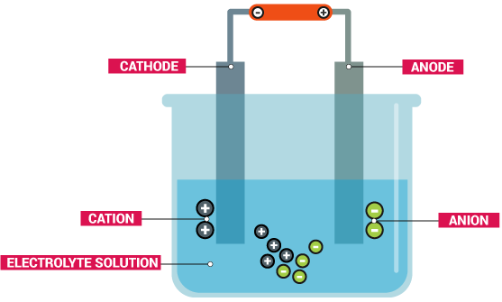
3) Apparatus for electrolysis
This diagram show the apparatus and will create a complete circuit as electrons are free to move
Believe it , Learnt it & Nailed it

Slide 7
4) What charge is cathode and what will be attracted to this one?
Believe it , Learnt it & Nailed it

Slide 8
4) What charge is cathode and what will be attracted to this one?
Negative and the cation will be attracted
Believe it , Learnt it & Nailed it

Slide 9
5) What charge is anode?
Believe it , Learnt it & Nailed it

Slide 10
5) What charge is anode?
Positive
Believe it , Learnt it & Nailed it

Slide 11
6) What charge is cation?
Believe it , Learnt it & Nailed it

Slide 12
6) What charge is cation?
Positive
Believe it , Learnt it & Nailed it

Slide 13
7) What charge is anion?
Believe it , Learnt it & Nailed it

Slide 14
7) What charge is anion?
Negative
Believe it , Learnt it & Nailed it

Slide 15
8) In a molten ionic solution what will be produced at the cathode?
Believe it , Learnt it & Nailed it

Slide 16
8) In a molten ionic solution what will be produced at the cathode?
The +ions in the solution to make the element
Believe it , Learnt it & Nailed it

Slide 17
9) In a molten ionic solution what will be produced at the anode?
Believe it , Learnt it & Nailed it

Slide 18
9) In a molten ionic solution what will be produced at the anode?
The -ions in the solution to make the element
Believe it , Learnt it & Nailed it

Slide 19
10) what is the rule at the cathode for aqueous element ?
Believe it , Learnt it & Nailed it

Slide 20
10) what is the rule at the cathode for aqueous element ?
If + ions (metals) are group 1,2, aluminium or acids then hydrogen will be produced. If +ions (metals) are less reactive than hydrogen, the metal will be produced.
Believe it , Learnt it & Nailed it

Slide 21
11) what is the rule at the anode for aqueous element ?
Believe it , Learnt it & Nailed it

Slide 22
11) what is the rule at the anode for aqueous element ?
If -ions are halogens like Cl-,Br- or I- then the halogens will be produced. If -ions are not an halogen like So4²⁻,NO₃⁻ then oxygen will be produced.
Believe it , Learnt it & Nailed it

Slide 23
12) what is the rule at the anode for aqueous element ? Exception
Believe it , Learnt it & Nailed it

Slide 24
12) what is the rule at the anode for aqueous element ? Exception
The electrodes are the same as the solution like if you have electrodes of copper and have a solution of copper compound, the metal anode will lose mass because the copper atoms change to copper ions and go into solution.
Believe it , Learnt it & Nailed it

