Slide 1
Light and electrons
BY Natasha fuller

Slide 2
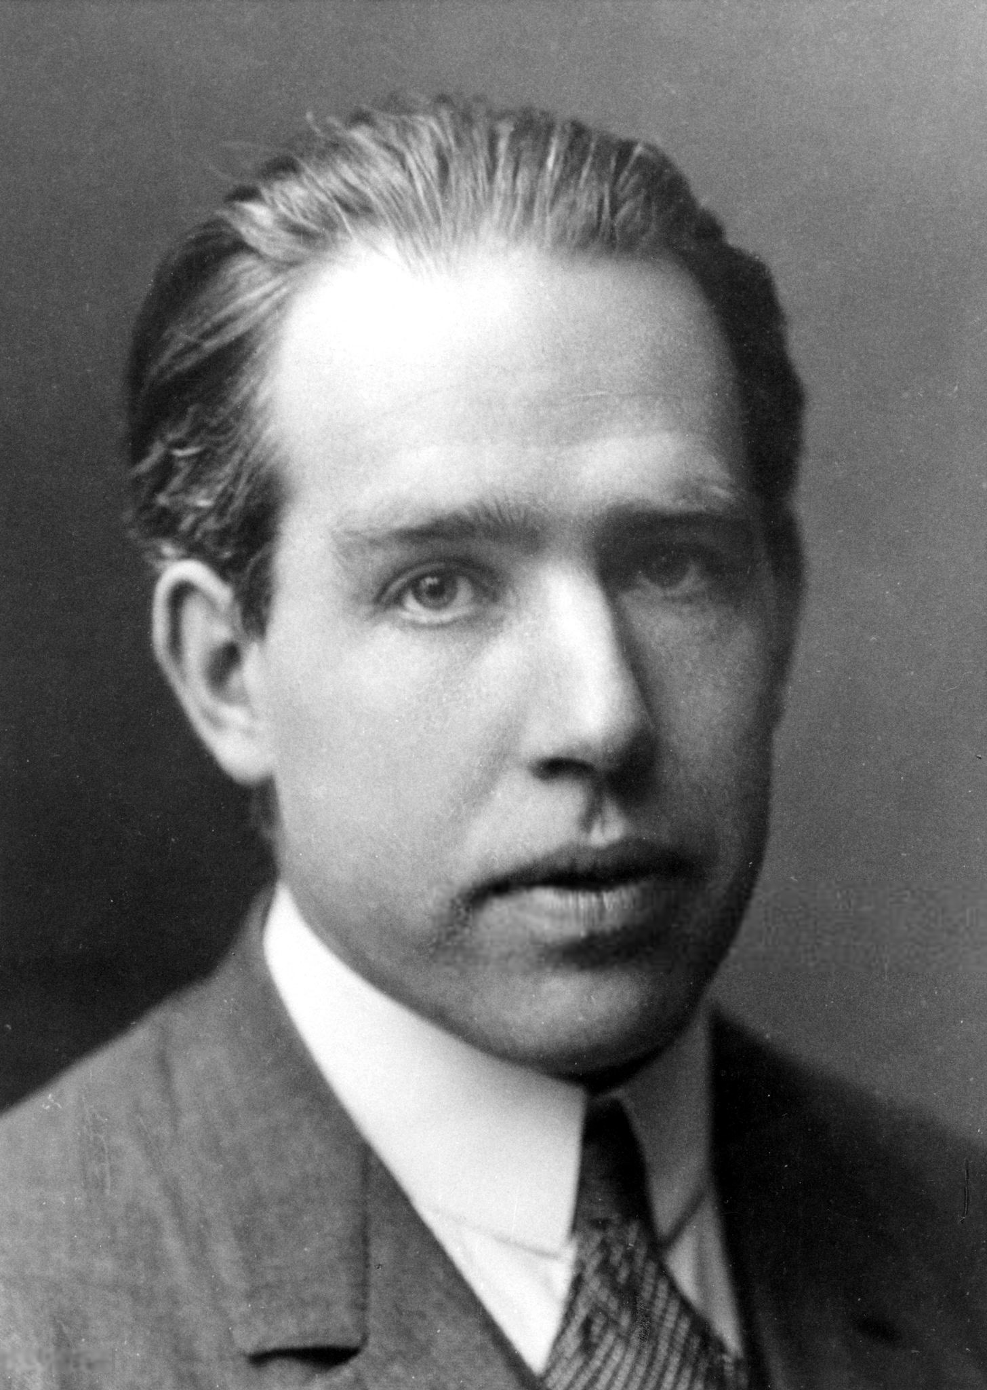
Bohr’s
Bohr’s theory was that electrons orbit the nucleus at specific distances away. All elements would have different distances because they have different energy levels. He proved and came to the theory that electrons cannot be arranged at random intervals and instead there are at fixed energy levels in each atom. This would explain why when you burn curtain chemicals, they create a specific coloured flame for an example lithium always creates a crimson red flame the pattern of energy released by an electron must be the same for every atom in the specific element otherwise they would be different Colours. Furthermore when atoms absorb specific amounts of energy, they can jump for one shell to another (move up shells to a higher energy level) and they can also emit a specific amount of energy and move down to a lower level. Each element requires a different specific amount of energy for this to happen.

Slide 3
What happens to electrons when they gain energy?
When electrons gain energy, they can jump to a higher energy level ( a shell further away from the nucleus) however this can only be done if the electron absorbs a specific amount of energy otherwise it will not move at all and this amount of energy is different for every element. Every electron absorbs a different frequency of energy
When electrons gain energy, they have absorbed a specific amount of energy that will have a specific energy wave. You can use a absorption spectrum. To find the specific energy wave. This is a coloured spectrum with black lies that indicate where there is an absorption the black shows the colors that it has absorbed.

Slide 4
What happens to electrons when light/proton is emitted?
When electrons emit light, they can move down shells to a lower energy level however this can only be done if they emit a specific amount of energy and for each atom this is different. This emitted light has a specific energy wave as the energy is unique for each element. You can use a emission spectrum to find the specific energy that has been emitted by an electron in an atom this is a black spectrum with colour bands. The colour bands indicate where light has been emitted form the specific energy wave.
We see different colour fireworks because different metals have emitted different light rays allowing us to see different colours.

Slide 5
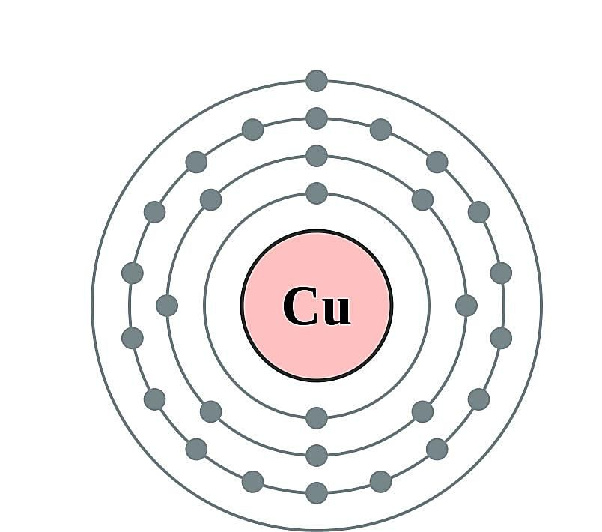
the relationship between a proton frequency and the electron energy levels
the relationship between a proton frequency and the electron energy levels. Is that they both will have the same amount of energy. In an atom the shells are evenly spaced out at specific distances away depending on the atom. Therefor for an atom to jump to another shell either by emitting energy or absorbing energy the same amount of energy is required for both otherwise the election just won’t move so the relationship is that the amount of energy is the same.
For an electron to move from shell to shell the same amount of energy is required . If its loosing or gaining energy it still needs to be the same

Slide 6
Similarities and differences between an absorption and emission spectrum.
Similarities
Differences
For the same element they will both show the same point on the spectrum. (the indicators will be at the same point)
You can use both spectrums to identify a specific element.
They both show a spectrum of colours and point of the spectrum that are different due to he energy wave.
Emission spectrum uses emitted energy to create the spectrum where as an absorption spectrum uses absorbed energy.
Emission has colours as its indicator to show the energy wave where as the absorption shows it using black lines
Emissions is a back spectrum with coloured lines and an absorption spectrum is a coloured spectrum with black lines

