Slide 1
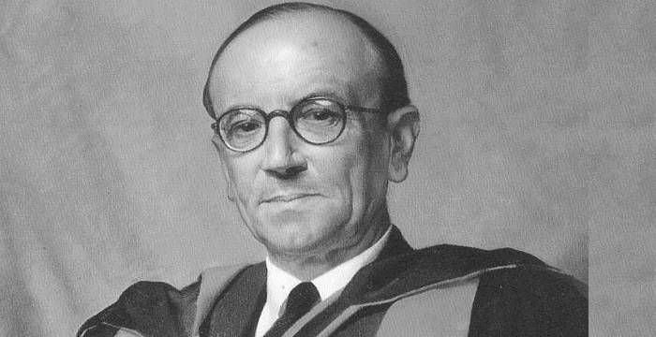
James chadwick
Natasha Fuller

Slide 2
Introduction
I am known for the discovery of the neutron and worked alongside may scientists to find the conclusion that neutrons do exist in the nucleus of an atom.
In 1913 I went to berlin to work with Hans Geiger however world war II broke out shortly after and I became a prisoner of war. During my time in prison I read books and talked to other physicists about this possible discovery but no experiments were allowed. When the war ended I came back to England and worked alongside Rutherford in Manchester and Cambridge to search for the neutron and carried out many experiments to back up the neutron conclusion.

Slide 3
What I already knew about the atom
From past discoveries by many scientists. I already knew a lot about the structure of the atom. I Knew that atoms had a small ball of positive charge in there centre, most of the atom is empty space and also that electrons orbit the nucleus of the atom at specific distances away. Furthermore from Moseley's discovery I also knew the atomic numbers for each elements (protons= electrons) creating a more organised representation of the periodic table.

Slide 4
The neutron
From the previous discoveries Ernest Rutherford in 1920 came up with a conclusion that there was a neutral particle in the nucleus of atoms because of the large difference between an elements atomic number and atomic mass.
some scientists at the time believed it was additional protons in the nucleus as well as there being an equal amount of electrons to cancel out the extra charge and Rutherford believed that you could combine the two to form a new neutral particle.
With these theories it was my job to work along side Rutherford to test his theory and find the evidence that there is in fact a third particle in an atom known as the neutron. This was difficult as a neuron has no charge.

Slide 5
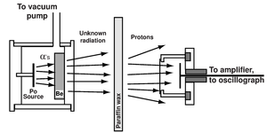
experiment
In 1930 it was discovered that when Beryllium was bombarded with alpha particles it emitted an extremely energetic stream of radiation and at the time it was assumed that it was gamma radiation. This conclusion however didn’t match with the law of conversation of energy, so my theory was that it was in fact neutrons.
My experiment to test my conclusion involved putting a piece of beryllium in a vacuum chamber with polonium which emitted alpha rays hitting the beryllium.
Form this experiment I found that the beryllium emitted unknown neutral rays. To find out more about this unknown ray I then placed a target made of paraffin wax at the path of rays. When the ray hit the target the atoms were knocked out, collisions took place and protons recoiled with a high velocity. The atoms which became electrically charged during collision fell into a detector that was full of gas. When these charged particles passed through the detector the gas became ionized which then moved to an electrode.
I then measured the current through the electrode allowing me to count the atoms and estimate their speed. I repeated this experiment using targets that where made from different elements such as helium, nitrogen, lithium etc. measuring the energy needed to eject the atoms.

Slide 6
Conclusion of my experiment
In conclusion my experiment proved that a gamma ray would not explain the speed of the atoms and that the best solution would be the neutral particle.
To further prove my conclusion I measured the mass of the neutron by calculating the mass of everything in the Collison. In conclusion I found that the weight of the neural particle was 1.0067 times bigger than the mass of the proton which wasn’t the same proving that the was indeed a neutral radiation which is named the neutron.
Also with the neutron having no charge they hit the target a lot faster than the protons this would explain the high velocity which further backed up my conclusion.
This effected the structure of the atom by the idea that in the nucleus of an atom there where neutral particles as well as protons which was a particle with no electric charge creating the mass number of the atom (number of protons and neutrons).

Slide 7
Sources
http://scienceline.ucsb.edu/getkey.php?key=1
http://dev.physicslab.org/Document.aspx?doctype=3&filename=AtomicNuclear_ChadwickNeutron.xml
https://www.aps.org/publications/apsnews/200705/physicshistory.cfm
https://www.google.com/search?q=james+chadwick&rlz=1CDGOYI_enGB906GB906&oq=james+chadwick&aqs=chrome..69i57j0l3.11369j0j7&hl=en-GB&sourceid=chrome-mobile&ie=UTF-8

