Slide 1
Bohr’s model of the atom + spectroscopy
By: Bansari

Slide 2
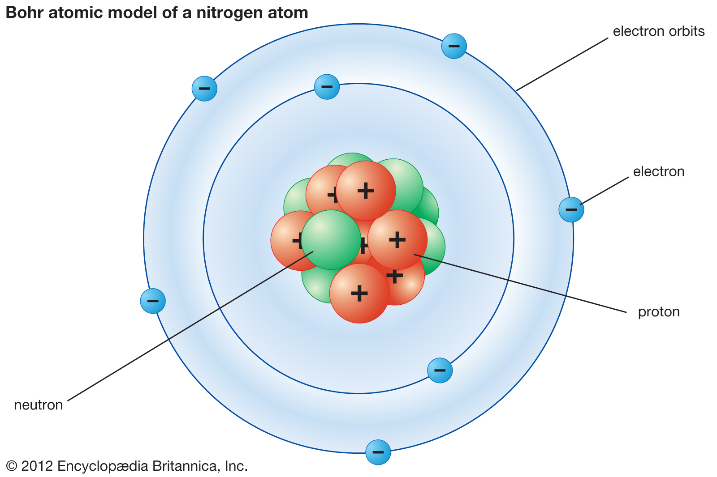
What was Bohr’s theory of atomic energy levels?
Bohr model was based on the theory of electron shells which describes the behaviour of light energy and frequency.
This was determined by his experiment using both emission and absorption spectrums.
He discovered using this simple experiment that electron shell exists in different energy levels.
The pattern of energy released by electrons in the chemical reaction must be different for every single atom of that element.
Therefore, electrons cannot be arranged at random, but they must have fixed levels of energy within each type of atom.
Electron can only exist as quantized ( fixed) with unique energy levels.
Energy of light depends on whether the electron is gained or lost.
Proposed a relationship between frequency of light being equal to the energy of light.

Slide 3
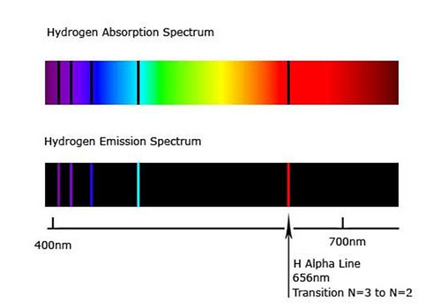
Emission spectrum vs Absorption spectrum
Absorption spectrum:
Absorption spectrum = spectrum that show black lines that correspond to its frequency of the energy shells.
This occurs when electrons gain energy and move up in shells.
Every energy level has a unique frequency which absorbs a specific energy to move up in shells.
All element have a specific absorption spectrum.
Emission spectrum:
Emission spectrum = black bands showing colours corresponding to energy emitted by the electron in an atoms.
This occurs when electrons lose energy and move down in shells.
This occurs when electrons move down the energy shells emitting electromagnetic radiation.
All elements has a specific emission rate spectrum.
This can be used to identify the element according to both spectrums.

Slide 4
Similarities and differences about emission and absorption spectrums
Emission spectrum:
Absorption spectrum:
Similaries:
Uses bands to show the unique energy levels/ frequency.
Both bands are equal as they both use the same amount of energy for absorption and emission.= black lines line up.
Differences:
Only accounts when electrons are lost
Energy is lost/emitted with one specific frequency.
Similarities:
Use black bands to show the unique frequency.
Both bands are equal as they both use the same amount of energy for absorption and emission. = lines line up.
Differences:
Only accounts when electrons are gained.
Energy is gained= energy is absorbed with fixed frequency.

Slide 5
Key points summary :
The electron in the hydrogen atoms only exists into specific energy shells/energy levels.
Photon = tiny packets of energy = related to the position of the light in the electromagnetic spectrum
a photon of light is emitted or absorbed when an electron changes from one energy level to another.
The energy of a photon is equal to the difference between the difference of 2 energy levels.
Energy emitted by the element = Frequency of light.
Energy of a photon = Planck constant x Frequency (▲E = hv)
Electron gains energy = Absorption spectrum = moves up the shells
Electron loses energy = Emission spectrum = moves down the shells

